Slide 1

Discovering the Evolution of Natural Language
From early machine translation attempts to advanced language models, we'll take a journey through the history of NLP and explore its impact on society

Slide 2
Emergence of Computational Linguistics
The Beginning
Early Attempts
With the mingling of language and computer sciences, the field of computational linguistics was born in the late 1950s.
Initial efforts at machine translation and data processing proved unwieldy and unsophisticated.
Major Breakthrough
The Future
This field's major breakthrough came in Georgetown-IBM experiment (1954), where the Georgetown Automatic Translation System managed to translate sixty Russian sentences into English.
These early efforts laid the groundwork for the future development of natural language processing technology and its growth over time.

Slide 3
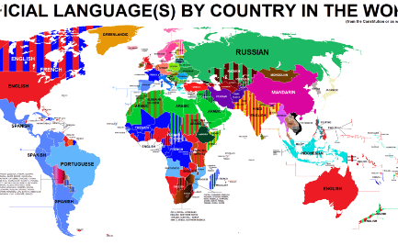

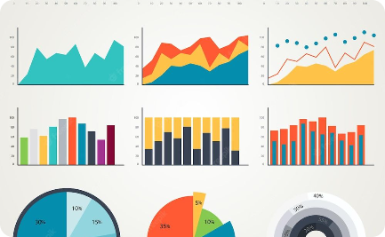
The Evolution of Rule-based Language Processing
Language Processing
Programming Code
Visualization
Rule-based language processing rose to the forefront in the 1980s, with systems that applied linguistic rules to language processing.
This approach relied on explicit descriptions of linguistic features and rules, which programmers coded into software.
Data visualization allowed for the representation of rule-based models, enabling developers to more easily see and understand how these systems worked.

Slide 4
Statistical Approaches to NLP
1
Machine Learning
2
Data-Driven
3
Wider Application
In the 1990s, machine learning emerged as the dominant statistical approach to natural language processing, backed up by algorithms such as support vector machines and decision trees.
These methods set aside explicit rules and instead relied on massive amounts of data and algorithms that learned rules on their own.
The wider application of statistical modeling led to the development of key technologies like search engines and spam filters.

Slide 5
Deep Learning Impact on NLP
Transformational Models
In the 2010s, the evolution of transformer models like GPT-3 dramatically improved the quality of natural language understanding and generation.
1
2
3
Introduction of Neural Networks
Enhanced NLP Applications
Neural networks were introduced in 2001 as NLP models, opening the door to more complex machine learning algorithms.
These models are extensively employed to execute specific functions, like Google Translate's neural machine translation capabilities.

Slide 6



Impact of NLP on Society
Voice Assistants
Digital Marketing
Medical Research
Enabled by natural language processing, voice assistants have transformed the way we carry out everyday activities like setting reminders, ordering groceries, and controlling technology.
NLP is also utilized in digital marketing to analyze the language employed by users online and presenting targeted ads or content accordingly.
NLP is widely used in medical research, as it can be used to extract valuable information from medical papers and clinical notes, assisting researchers in making more accurate diagnoses and developing new treatments.

Slide 7
Future Prospects and Innovations
Relationship between NLP and AI
Controlling Bias
NLP can play an important role in preventing and reducing systemic bias by removing author bias and applying ethical standards to itself.
The advancement of NLP is intrinsic to the rise of AI. As a result, the future of NLP is tied to the growth of machine learning models in different domains, including vision, speech, and reasoning.

Slide 8

Multilingual and Cross-Lingual Advances
1
Translation
2
Language Learning
With the aid of artificial intelligence and deep learning algorithms, translation advancements have been made that will ultimately pave the path for massive language communication and cooperation.
Advancements in natural language processing have propelled language learning technology in recent years, making it possible to learn foreign languages by interacting with computers utilizing natural language processing algorithms.
3
Widespread Adoption
The widespread adoption of natural language understanding and generation technology is having a remarkable impact on breaking down global barriers and increasing cross-culture collaboration across the globe.

Slide 9
NLP's Role in Language Translation
Early Machine Translation: NLP's history includes pioneering efforts in machine translation, paving the way for global communication.
Evolution of Translation Models: From rule-based to statistical to neural machine translation, NLP has transformed how languages are translated.
Multilingual Communication: NLP-enabled translation tools bridge language barriers, enabling cross-cultural understanding and collaboration.
Real-World Impact: NLP-driven translation empowers international business, diplomacy, and global communication.

Slide 10
Challenges in Early NLP Development
Data Limitations: Early NLP struggled due to limited data availability and computational resources.
Linguistic Complexity: Understanding nuances, idioms, and context posed challenges for early NLP models.
Lack of Tools: Absence of advanced algorithms hindered accurate language processing and analysis.
Evolution Overcome Challenges: Despite initial hurdles, NLP's evolution addressed these challenges, leading to its current capabilities.

Slide 11
Ethical Considerations in NLP History
1
Bias Mitigation
2
Privacy Protection
3
Ethical AI
NLP addresses bias concerns in language processing, aiming for fairness.
Ensuring personal data privacy when handling textual information.
Applying ethical standards to NLP models for responsible AI applications.

Slide 12
NLP 's Impact on Society
1
Healthcare Advancements
2
Education Enhancement
3
Financial Insights
NLP-driven analysis aids in market predictions and financial decisions.
NLP assists medical professionals with patient records and diagnostics.
Language learning apps leverage NLP for interactive learning experiences.

Slide 13
Continued Growth and Evolution
Expanding Applications: NLP's influence extends to industries like law, entertainment, and hospitality.
Research Frontiers: Ongoing research explores new NLP models and applications.
Interdisciplinary Collaboration: NLP's growth relies on collaboration across AI, linguistics, and technology.

Slide 14
Empowering Language-Driven AI
Human-Like Interaction: NLP advances enable more natural and context-aware interactions.
AI Companions: Virtual assistants evolve into intelligent companions, understanding emotions and context.
Conversational Interfaces: NLP powers chatbots that replicate human-like conversations.

Slide 15
Conclusion: NLP's Transformative Journey
From its humble beginnings to today's advanced models, NLP's evolution has revolutionized language interaction.
Enhancing Lives: NLP's impact spans communication, accessibility, and decision-making.
Unleashing Potential: NLP continues to shape AI's capabilities and drive innovation.

